Slide 1
FallAlert: A Mobile Application for Real-Time Fall Detection and Emergency Assistance
Project Presentaion for ENGG*6400 Mobile App Development
Team members: Xunzhong Qin Student ID: 1307098 Om Bhosale Student ID: 1293903

Slide 2
Introduction
The project aims to design and implement an Android application, "FallAlert," which detects falls in elderly individuals or workers in hazardous environments.
The app provides immediate assistance by making an emergency call or sending a text message to the pre-configured contacts.

Slide 3
Background
We have the experience of developing software for emergency dispatch center, understanding the requirements from different kinds of emergency situations, especially for the people who lives or works alone. It’s very important to help them send out the alert automatically in case of they lose the capability to ask for help.
As we are learning the mobile app development as well as machine learning, it motives us to do the research in this area and start developing this app. The technologies and ideas can also be used in many other wearable devices like smart watch, helmet etc.

Slide 4
Objectives
Fall Detection: Implement reliable fall detection algorithms in real time using smartphone sensors.
Emergency Alert: Automatically initiate an emergency call or send a text message with the current location and fall details to emergency contacts when a fall is detected.
User-Friendly Interface: Design an intuitive and simple user interface suitable for elderly users.
Customizable Settings: Allow users to customize emergency contacts, SMS text message templates, and waiting time before initiating an automatic emergency call.
Machine Learning Integration: Develop and train a machine learning model to improve the accuracy of fall detection by analyzing accelerometer and gyroscope data, reducing false positives and enhancing overall detection reliability.
Battery saving strategy: This might be the big challenge to release the app to public user as phone manufactures will kill the app to save battery, it’s hard to keep it running in the background.

Slide 5

Proposed Approach
Leverage the Android smartphone's accelerometer and gyroscope to develop an algorithm that monitors movement and detects falls.
Create and Pre-train a tensorflow Lite model using training data from UCI Machine Learning Repository.
Integrate the model into APP and feeding the collected sensor data to predict the fall

Slide 6
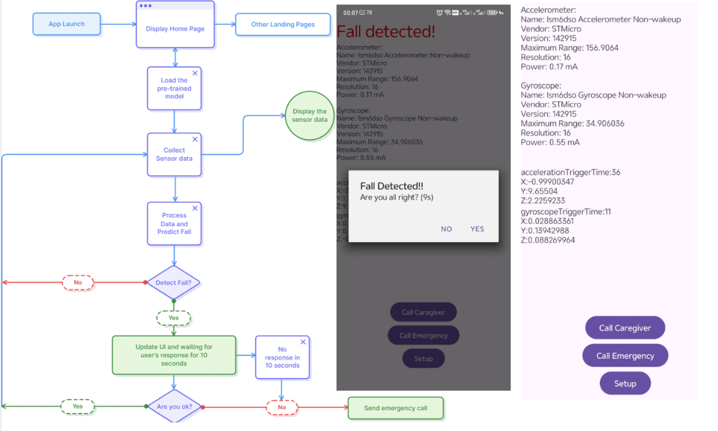
Block Diagram - APP

Slide 7
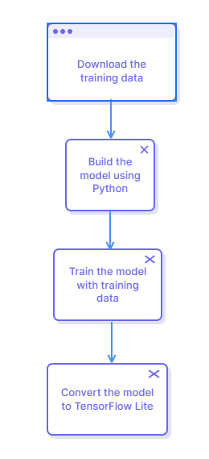
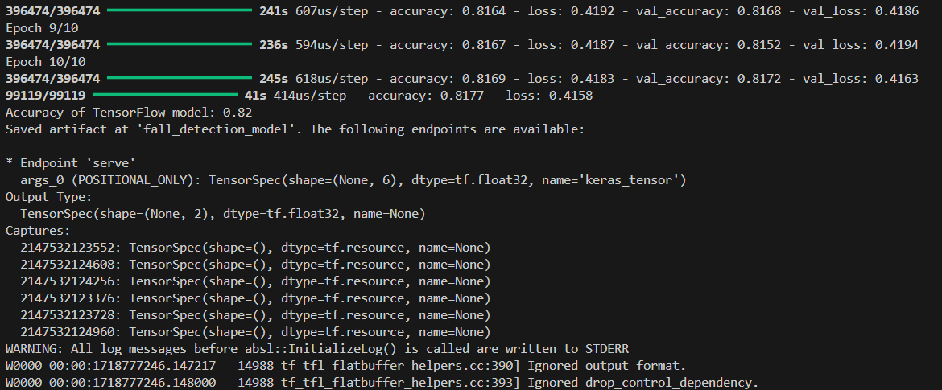
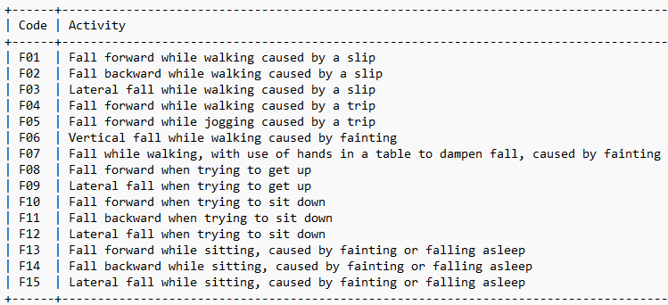
Block Diagram - Model

Slide 8
Conclusion
"FallAlert" aims to address a critical need for safety among elderly individuals and workers in hazardous environments by leveraging mobile technology for real-time fall detection and emergency assistance.
The project's success will rely on thorough research, user-centered design, and rigorous testing to ensure reliability and ease of use.

Slide 9
References
[1] K. Yildirim, G. Ucar, T. Keskin, and A. Kavak, “Fall Detection Using Smartphone-Based Application”, International Journal of Applied Mathematics Electronics and Computers, vol. 4, no. 4, 2016.
[2] Islam, M.M., Neom, N.H., Imtiaz, M.S., Nooruddin, S., Islam, M.R., Islam, M.R. (2019). A review on fall detection systems using data from smartphone sensors. Ingénierie des Systèmes d’Information, Vol. 24, No. 6, pp. 569-576. https://doi.org/10.18280/isi.240602

Slide 10

Thanks!

